Slide 1


Social Prescribing, Health Inequalities and Black, Asian and Minoritised Ethnic Communities
Dr Jahan Foster Zabit October 2024

Slide 2

Race Equality Foundation
Who we are:
Led by Black, Asian and ethnically minoritised people, we are an evidence-based, policy and practice charity working to tackle racism and racial inequalities.
Our vision:
A society without racism.
Our mission:
To tackle racism in UK society and positively transform the lives of our Black, Asian and ethnically minoritised communities.

Slide 3

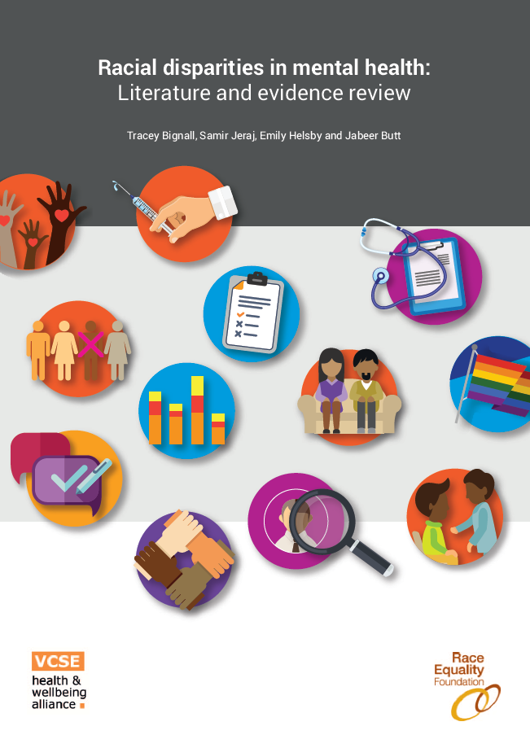
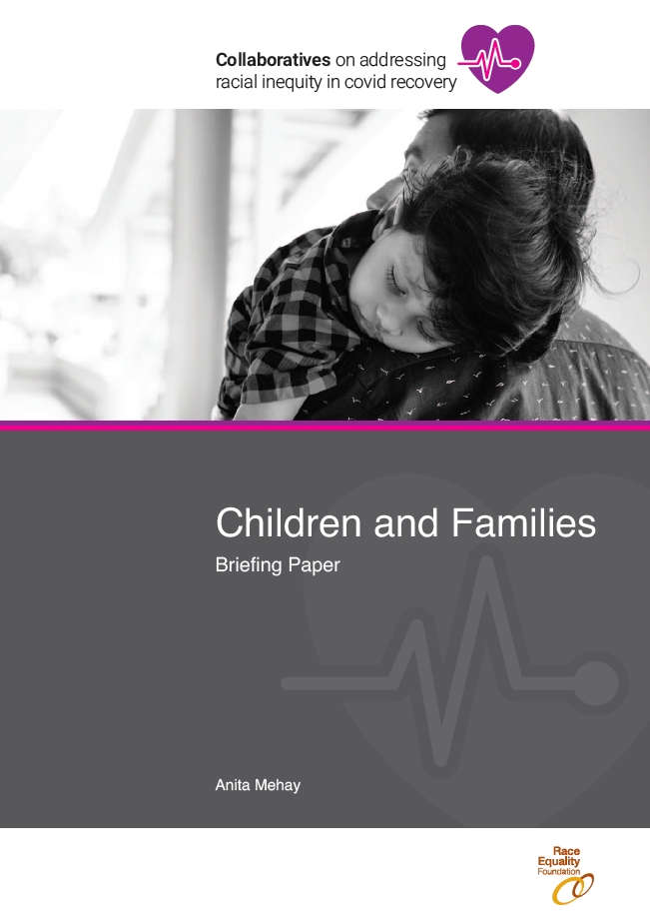
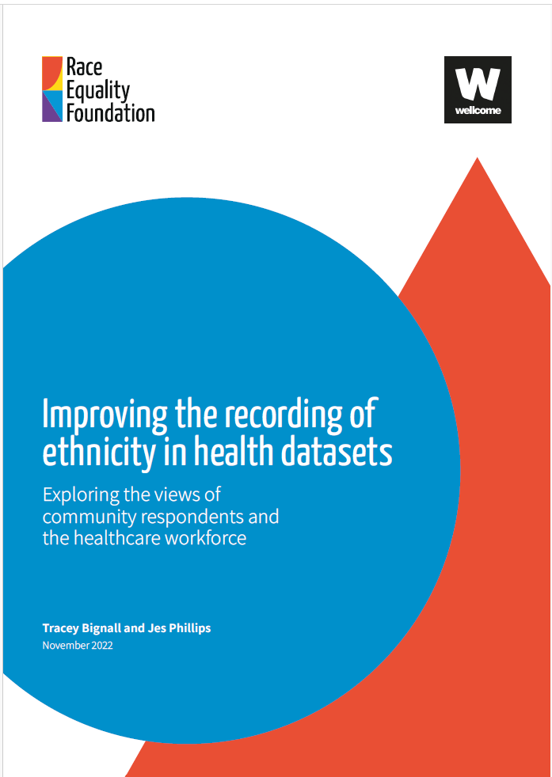
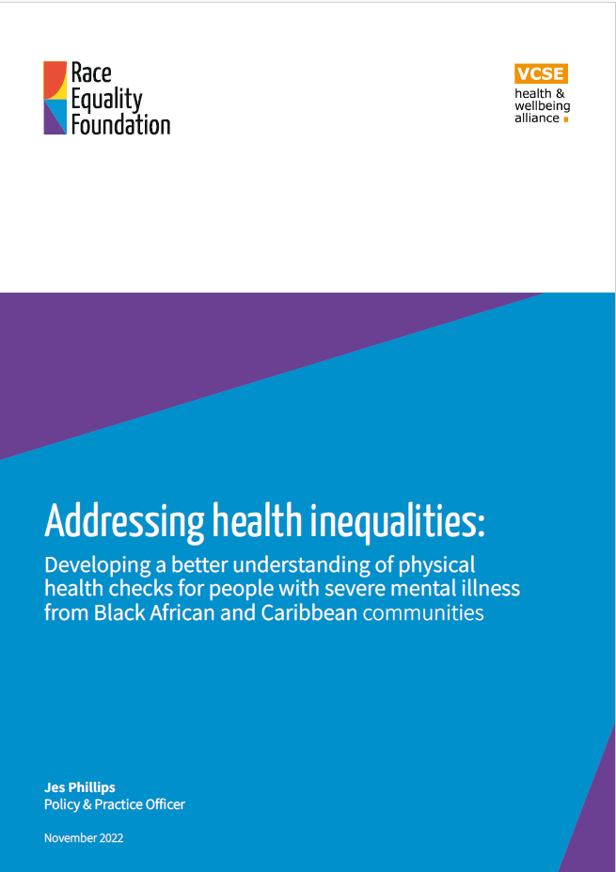
Some of our work
A qualitative study on the recording of ethnicity in health settings
Report on physical health checks for people with severe mental illness
A community based approach to improving blood pressure monitoring
A literature and evidence review of racial disparities in mental health
A series of briefings as part of the race equity collaboratives on the impact of Covid 19 and what should happen next

Slide 4
The promise of social prescribing
Designed to address health issues influenced by non-medical factors
Core principle: reduction of health inequalities
Key components
Referrals to local, non-clinical support and services
Addresses social determinants of health (e.g., poor housing, financial pressures, social exclusion)
Examples: Befriending groups, debt management services, nature-based activities
NHS Long Term Plan commitment: 900,000 referrals by 2023/24
Grown significantly across England since 2019
March 2024: approximately 3,600 SPLWs and over 2.6 m. referrals
Facilitated by Link Workers

Slide 5
What do we know about the impact of social prescribing?
Positive outcomes
Improvements in self-esteem, confidence, mental well-being
Reductions in anxiety and depression
Enhanced social connectedness and overall well-being
Reduced loneliness

Slide 6
What’s missing in our understanding of social prescribing and ethnicity?
Limited data on ethnicity
Underrepresentation of minoritised ethnic communities in data
Lack of location-specific data
Few studies in diverse urban areas
Small-scale studies
Poor design and inadequate reporting
Limited inclusivity of social prescribing initiatives

Slide 7
What did we do?
Study focus: London (most diverse region in England) and Kirklees, West Yorkshire
Data sources:
Islington: Comprehensive data over two years (Dec 2021 - Nov 2023), 3236 clients
Kirklees: Detailed data from April 2023 to December 2023, 4927 referrals
Camden: Specific initiative data (2022-2023)
Ealing: Specific project data (Oct 2022 - Feb 2023)
Methodology:
Analysis of referral patterns, demographic breakdowns, and outcomes
Compared data to 2021 Census

Slide 8
What did we find?
Key finding: Higher referral rates for minoritised ethnic communities compared to population size
Kirklees
Asian/Asian British: 29% of referrals (19.4% of population)
Black/Black British: 4% of referrals (2.3% of population)
Islington
Black, Black British, Caribbean or African: 18% of referrals (13.3% of population)
Asian or Asian British: 8% of referrals (9.9% of population)

Slide 9
Is social prescribing reaching those who need it most?
Known health inequalities for Black, Asian and minoritised ethnic communities
Higher prevalence of certain conditions (e.g., high blood pressure, coronary heart disease, Type 2 diabetes)
Higher poverty rates (twice as high on average)
Disproportionate impact of COVID-19
Kirklees data: 35% of referrals from top 20% most deprived areas
Islington data: Most prevalent conditions – depression and anxiety

Slide 10
What do the gaps in data tell us?
Challenges in ethnicity recording
Inconsistent categories (e.g., multiple options for "White British")
High rates of unrecorded/refused data
Impact on analysis
Difficulty in cross-sectional examination (e.g., ethnicity vs. age, socio-economic status)
Limited understanding of specific health needs by ethnic group
Data quality
Lack of detailed outcome data by ethnicity in some areas
Missing or incomplete data

Slide 11
Examples of targeted action
Camden
Targeted initiative for people from Asian, Black, Somali, and Arab backgrounds
Strategies: Multilingual staff, community outreach
Result: Increased ethnic minority representation from 56% to 65%
Breakdown: 25.6% South Asian, 13% Somali, 7.4% Arabic, 15.3% Afro-Caribbean
Ealing
Focus on isolated minoritised ethnic people aged over 65 years
25 referrals: 56% White, 32% Asian, 8% Black British, 4% other
Outcomes: 17% decrease in GP follow-up appointments, 11% accessed additional community support

Slide 12
Lessons learned
Data-driven tailoring of support services
Identifying specific concerns and needs within communities
Importance of culturally competent staff
Recruitment from diverse backgrounds
Multilingual capabilities
Community engagement through relevant channels
Engaging with community centres, religious sites, cultural events
Patient-centred care approach
Addressing specific needs and preferences
Leading to high satisfaction levels

Slide 13
How to turn insights into action?
Promising signs
Social prescribing is reaching Black, Asian and minoritised ethnic communities at higher rates compared to population size
Potential to address health disparities effectively
Areas for improvement
Enhance data collection and analysis
  Standardise ethnicity categories
  Increase response rates for demographic data
Develop culturally competent services
  Training for healthcare providers
  Tailored interventions based on community needs
Conduct more comprehensive research
  Larger-scale studies with robust methodologies
  Focus on long-term outcomes and cost-effectiveness

Slide 14
What next?
How can you improve ethnicity data collection in your organisation?
What steps can you take to enhance cultural competency among staff?
How will you engage with local Black, Asian and minoritised ethnic communities to understand their health and care needs?

Slide 15
Find out more
Dr Jahan Foster Zabit
Senior Researcher
Race Equality Foundation
jahan@racefound.org.uk
https://raceequalityfoundation.org.uk

